Slide 1

LAB 8 – PROCESSES, SSH AND FIREWALLS
DAPHNE GWYNETH CAMODOC

Slide 2
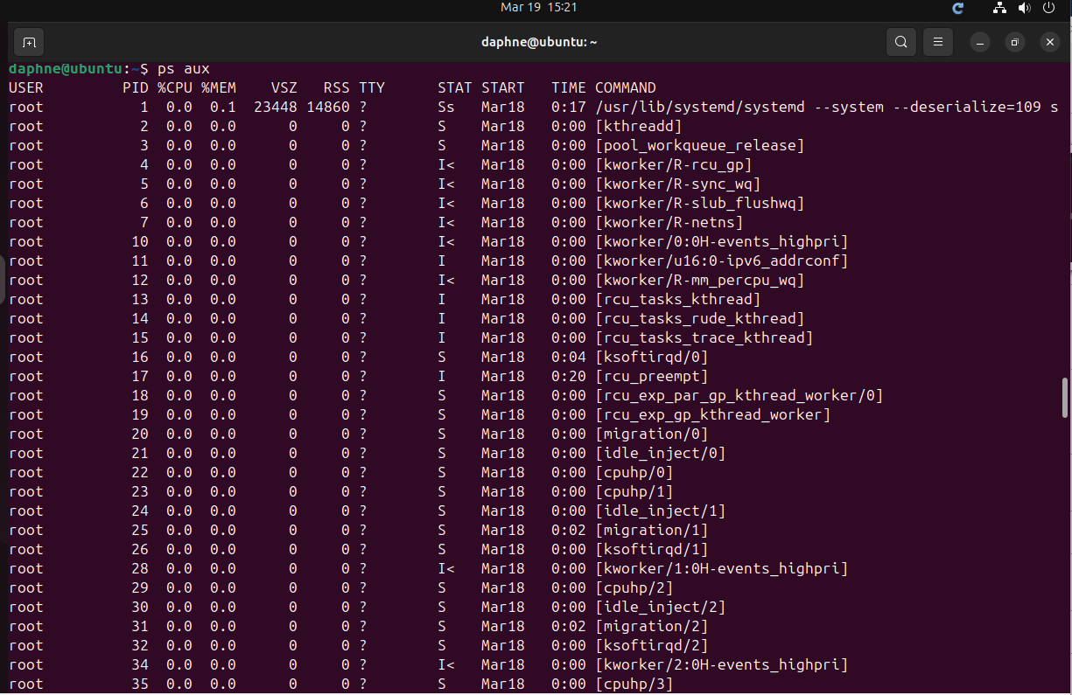

PART 1 How you would find the PID of a process - using ps command or ps aux command

Slide 3
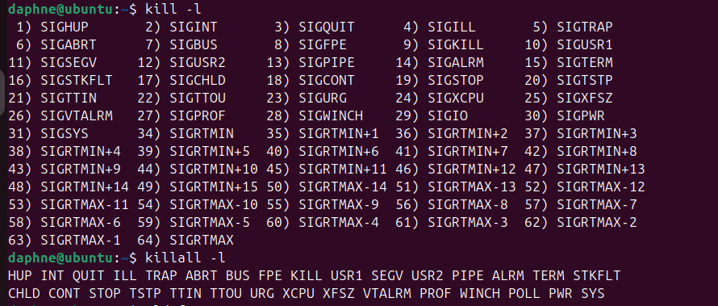
How to kill a process > to display available signals you can use the kill -l command > you can also use “kill [signal] PID” command to kil a process

Slide 4
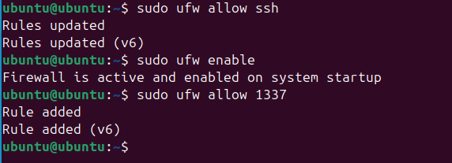
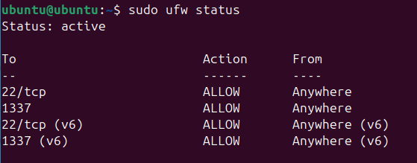
PART 2 Installing and configuring the Ubuntu Firewall using UFW using the commands: > sudo ufw allow ssh > sudo ufw enable > sudo ufw allow 1337 And to check the status of your ufw use the command: > sudo ufw status

Slide 5
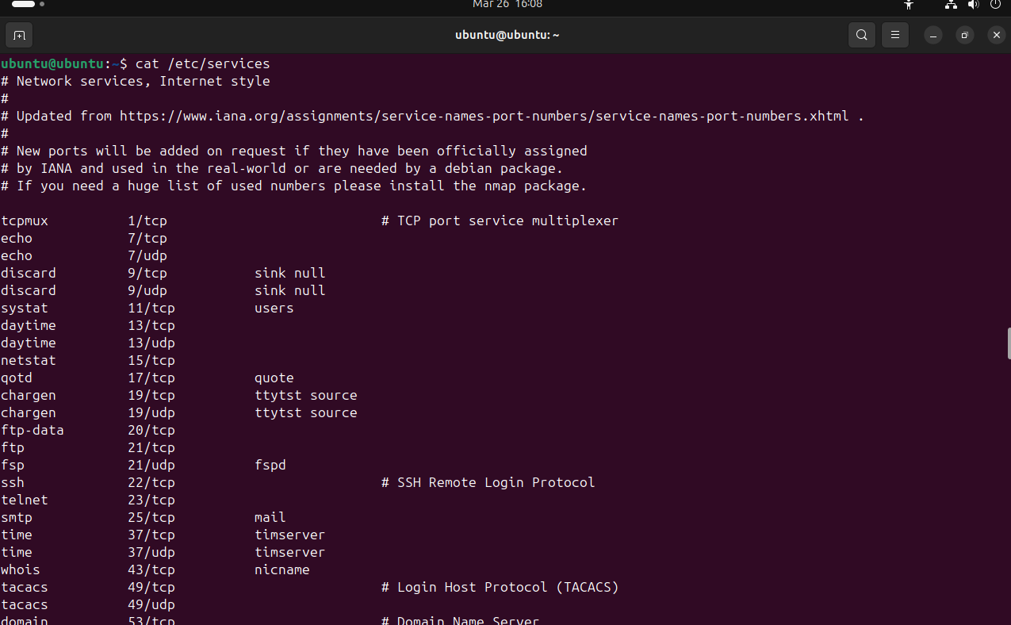
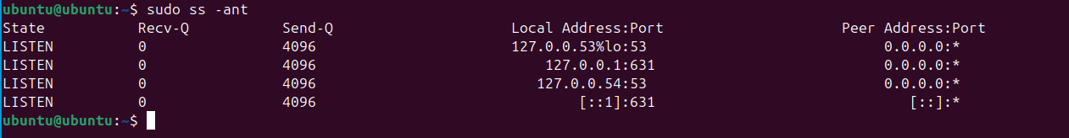
how to see what ports are open and what ports are listening using the command: > ss -ant and to check the network services and ports mapped to them you can use the command: > cat /etc/services

Slide 6
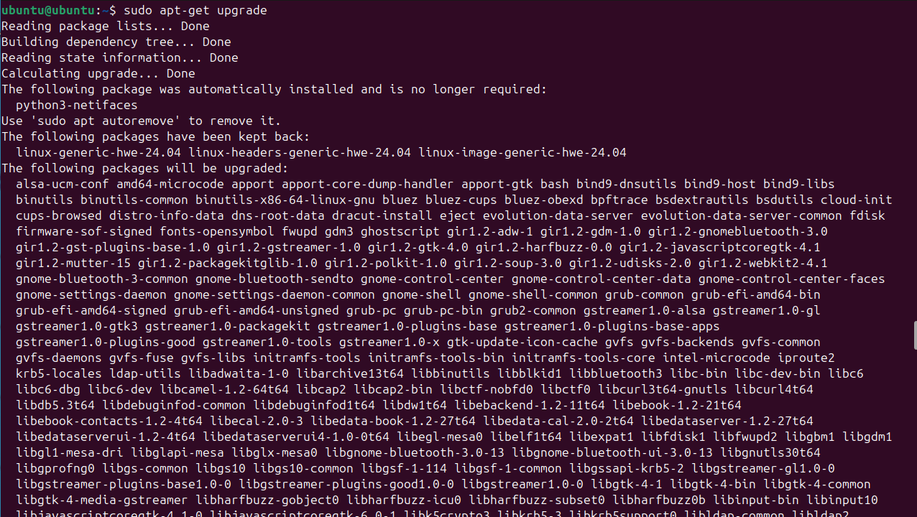
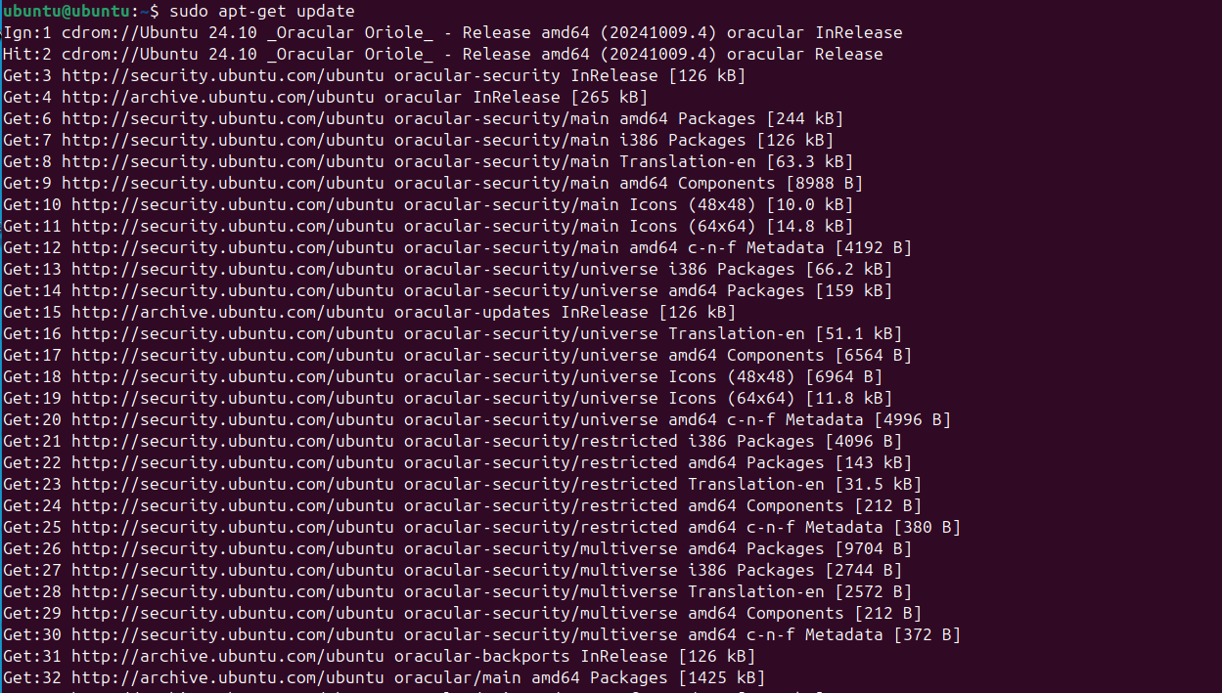
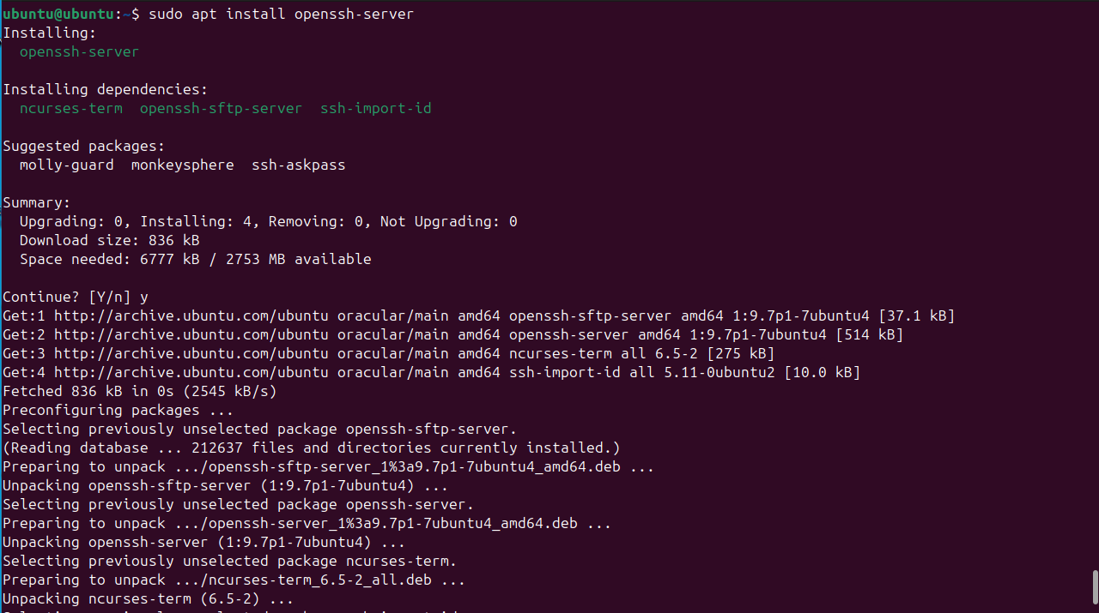
Install ssh-server by tying the commands: > sudo apt-get update > sudo apt-get upgrade > sudo apt install openssh-server Once the installation is complete, SSH service will start automatically. You can verify that SSH is running by typing “sudo systemctl status ssh”

Slide 7
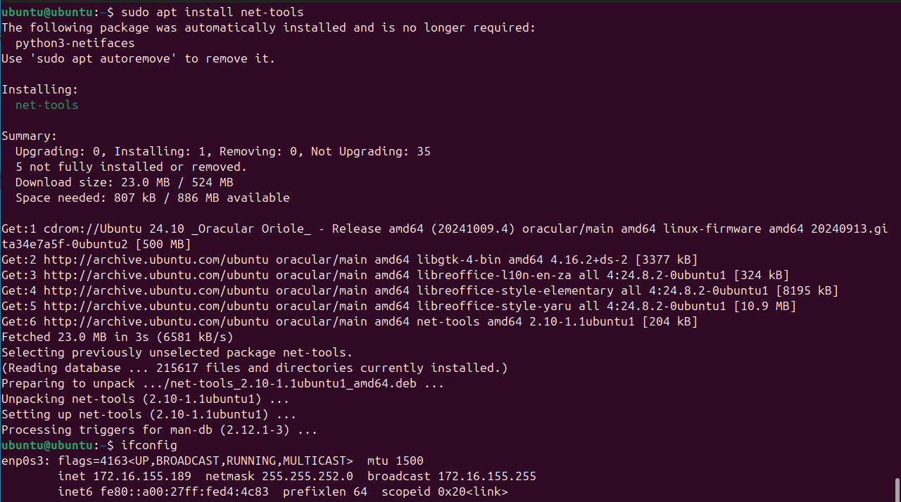
Create the connection with ssh and putty. You need to know your ip address first using the ifconfig command. If you don’t have it yet you can install it by typing the command “sudo apt install net-tools”

Slide 8
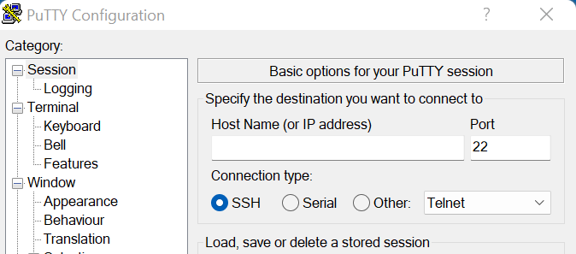
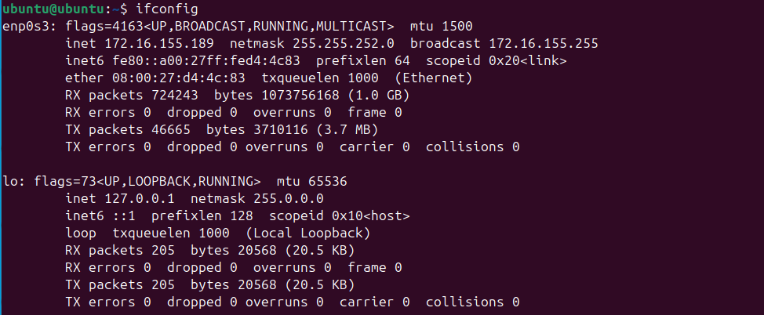
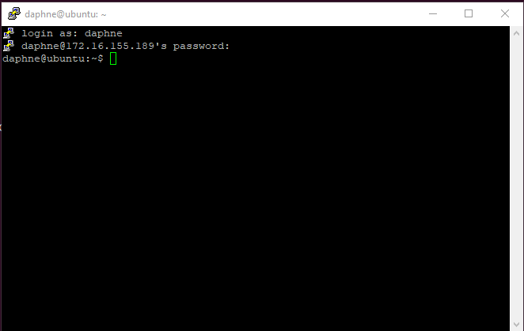
Type ifconfig and you can now see your ip. To connect to the putty, put your ip address and login your user and put your password to access

